Slide 1
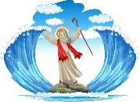
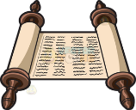
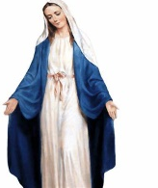
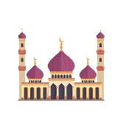
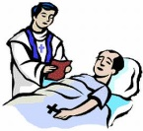
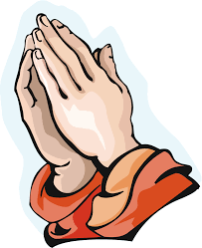
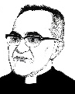
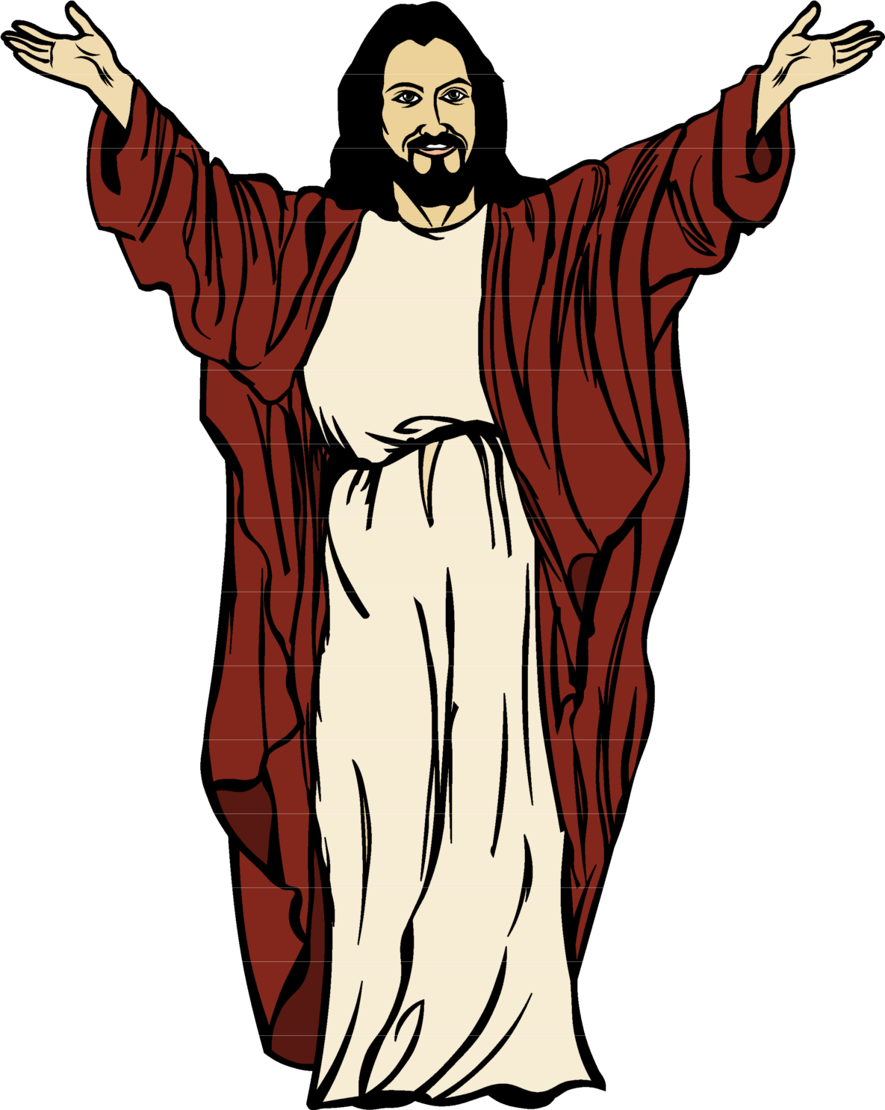
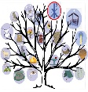
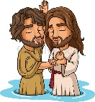
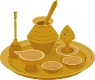
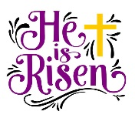
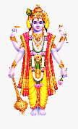
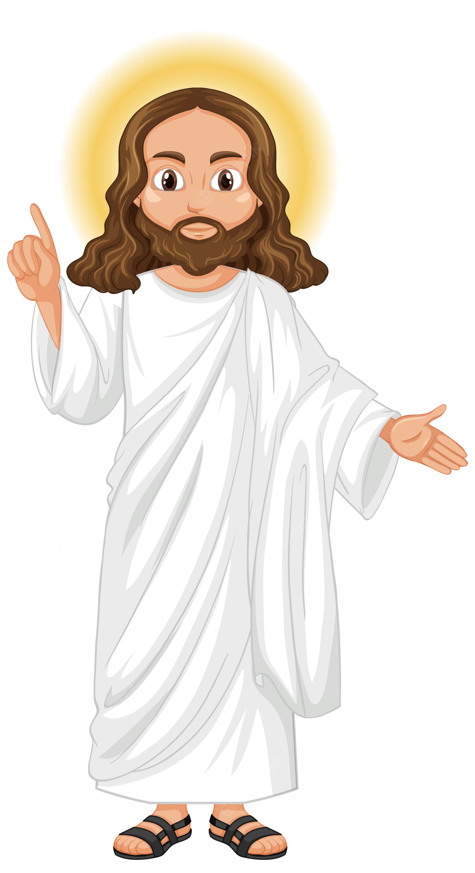
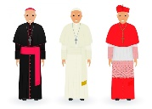
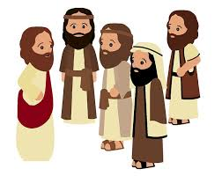
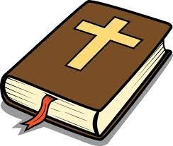
Moses
Galilee to Jerusalem assessment
Learning Journey
Religion&Science
Kosher food
Who was Moses?
Introduction to Judaism
What does Creation say about God?
Pikuach Nefesh
The Tenakh
The Greatest Commandment
Sin
Jewish Prayer
Who was Abraham?
RC Christianity
Judaism
The Mitzvot
Sacrament of Reconciliation
Stewardship
Jewish
festivals
The Jewish Halakhah
Diversity in Judaism
Year 9 Exam
The Incarnation
The Shabbat
Holocaust / Nicholas Winton
Restorative justice
The Paschal Mystery
Capital Punishment
Christian Attitudes to forgiveness
The Magnificat
Liturgical Calendar
Mary’s call
Genesis
Dignity and Sexuality
What is War?
Marian Shrines
Abortion
Marriage
The United Nations
A call to peace
Creation& Covenant
Peace and Conflict
Religious Conflict in families
Marian Devotion
Advent
The Incarnation
Euthanasia
Pro-Life responses
Wedding Ceremony
Religious Organisations and Peace
Different Christian attitudes to war
Prophecy
and Promise
Creation & Covenant
What happens when it goes wrong?
The just war theory
Mary
People of God
The Trinity and the Creed
Women in the Old Testament
Vatican 2
Vocation
Year9
The 5 pillars
Rites of passage in Islam
The
Mosque
Holy Orders
Typology
Candles in the Dark
Lord what do you want me to do?
Who was Muhammad?
Parable of the Sheep and Goat
The Betatittudes
Confirmation
The Holy Spirit
Muslim festivals
Introduction to Islam
Martin Luther King
Corrie Ten Boom
Mother Teresa Marcus Rashford
Sacrament of the Sick
Gifts of the Holy Spirit
Why does God allow suffering?
Dialogue and encounter
Why do we suffer?
Jesus – the suffering servant
St Paul and the resurrection of the dead
The Qur’an
Ecclesiam Suam
Preparations for Lent
The sacrament of Reconciliation
Vatican II
Healing and Anointing of the sick
Desert to Garden
To the ends of the Earth
Parables
Galilee to Jerusalem assessment
The Easter Triduum
Desert to Garden Assessment
belief in life after death
Catholic
funerals
To the Ends of the Earth assessment
Miracles
Oscar Romero
Galilee to Jerusalem
Prophecy and Promise assessment
The Prophets
Three-Fold office of the Church
Pacifism and conscientious objection
War
Sin
The conscience
Prayer
Year8
The marginalised
Prophecy and Promise
Creation and Covenant
Who was Jesus
Rules and morality
Mandir
Jesse Tree
Prophecy
John the Baptist
What is a prophet
Baptism
Hindu Gods and Goddesses
Confirmation
Hindu
worship
Being Christ-like
The Paschal Mystery
Eucharist
Mass
St. Luke
Councils of Nicaea and Jerusalem
Dialogue and Encounter
Pentecost
The Trinity in worship
From Desert to Garden
To the Ends of the Earth
Denominations
Sacraments
The last supper
Response to world hunger
The Holy Spirit
Nicene Creed
The Trinity
Father Mychal Judge
Pentecost around the world
From Galilee to Jerusalem
Genesis creation accounts
Incarnation
The Old Testament
Translations of the Bible
Science & religion
Jesus’ titles
The Fall
Revelation
Stewardship
Year
Prophecy and Promise
Creation and Covenant
7
Ecumenical councils
Biblical idioms
The Bible
Imago Dei
How we read the Bible
Use of scripture in worship
Catholic social teaching
Church
visit
Prayer
Scripture inspiration and the Magisterium
Laudato Si
The life of a religious scientist
The Trinity in worship

