Slide 1
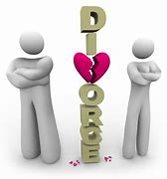
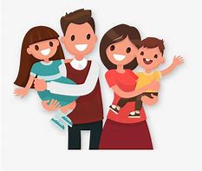
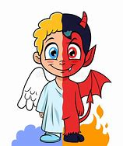
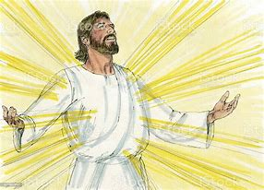
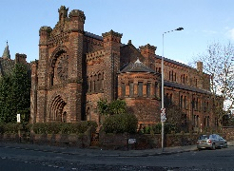
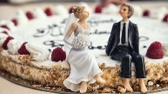
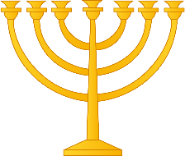
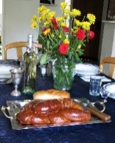
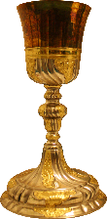
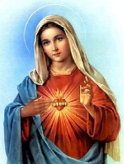
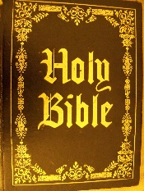
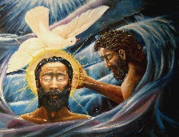
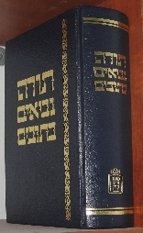
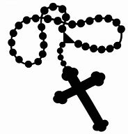
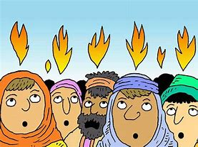
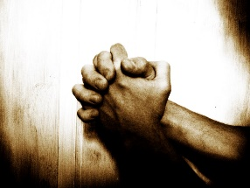
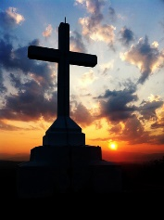
Identifying and understanding customer needs
Key Stage Four Learning Journey
Paper 3- Philosophy and Ethics
Gender prejudice and discrimination
Divorce and remarriage
Support for the family
Sexual relationships
Marriage
Relationships and families in the twenty-first century
Equality of men and women
Contraception
Families
Visions
Miracles
The design argument
Responses the problem of evil
Arguments for the existence of God
Religious experience
The cosmological argument
The problem of evil
Paper 1- Catholic Christianity
Revelation as proof of the existence of God
Shabbat
Shema and Amidah
Tenakh and Talmud
Judaism Beliefs &Practices
Features of the synagogue
Festivals
Rituals and ceremonies
Prayer
Public worship
Sculptures and statues
Drama and plays
Shekhinah
Messiah
The covenant with Abraham
Year 11
Jewish Beliefs about Life After Death
Sacred objects
Catholic Forms of Expression and Judaism beliefs and teachings
Internal features of the church
Paintings, frescos and drawings
Symbolism and imagery
Music in worship
The Nature of the Almighty
The Covenant at Sinai
Sanctity of Life
Moral Principles and the Mitzvot
Architecture and design of Catholic churches
The four marks of the Church
Second Vatican council
The Bible
Catholic Sources of Wisdom
Personal and ethical decision making
Mary as a model of the Church
Church as the Body of Christ
The magisterium
Interpretations of the Bible
The Sacraments
Liturgical worship
Prayer
Catholic social teaching
Catholic Practices
Mission and evangelism
Eschatology
The Catholic funeral rite
Forms of popular piety
Pilgrimage
The Significance of the Paschal Mystery
The Incarnation
Biblical understandings of the Trinity
Catholic Beliefs and Teachings
Year 10
The Paschal Mystery
Significance of Creation
Creation
The Trinity.
Paper 2- Judaism
GCSE Syllabus: Edexcel Specification A

