Slide 1
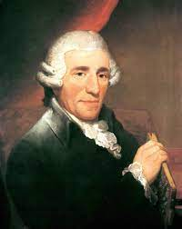
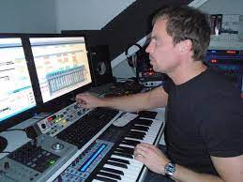
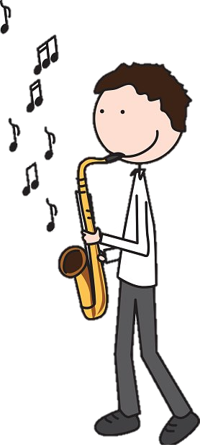
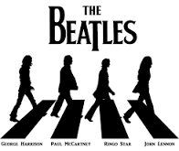
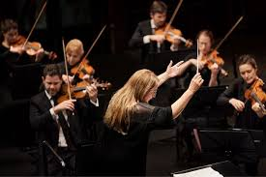
Key Stage 5
A Level Music
Appraising Exam
Submit Compositions
Recital
Into the 20th Century
Study the changes in style within Classical Music
AOS B Pop Music Practice Questions
20th Century
Set Work
Poulenc Trio
20th Century
Set Work Debussy ‘Nuages’
Free Composition
Refine and prepare Log for submission
Development of the Symphony-essay practice
Development of the Symphony’
Brief Composition
Choose and develop your composition from the Briefs released in September
Haydn Synphony 104 3rd Movement
Mendelssohn 3rd movement in brief
AOS B
Popular Music
1990s
,
Haydn Symphony 104 4th Movement
Mendelssohn 4th movement in brief
Solo Performance
Preparing your recital
13
Free composition-settle on composition to submit
AOS B Pop Music Practice Questions
AOS B
Popular Music
1980s
,
Haydn Synphony 104
2nd Movement
Mendelssohn No4 mvtmt 2 ‘In brief’
Solo Performance
Composition in a Classical style
Development of the Symphony-essay writing
. Main composers and works throughout the Western Classical Tradition
Haydn Synphony 104
1st Movement
Mendelssohn No4 mvtmt 1 ‘In brief’
AOS B
Popular Music
1970s
’
Solo Performance
Composition in a Baroque Style
Score reading techniques
‘Free’ Composition
Free composition-effective research and composing without a given ‘brief’
Solo performance introduction to mark scheme!
Composition Techniques
12
Intro to Area of study A: The Western Classical Tradition covering The Development of the Symphony, 1750 – 1900
Introduction to A Level Music and it`s components
AOS B
Popular Music
Study of songs in the 1960`s
Welcome to SNCHS 6th Form!

