Slide 1
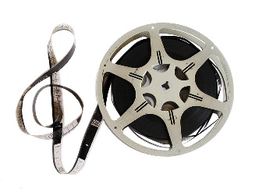
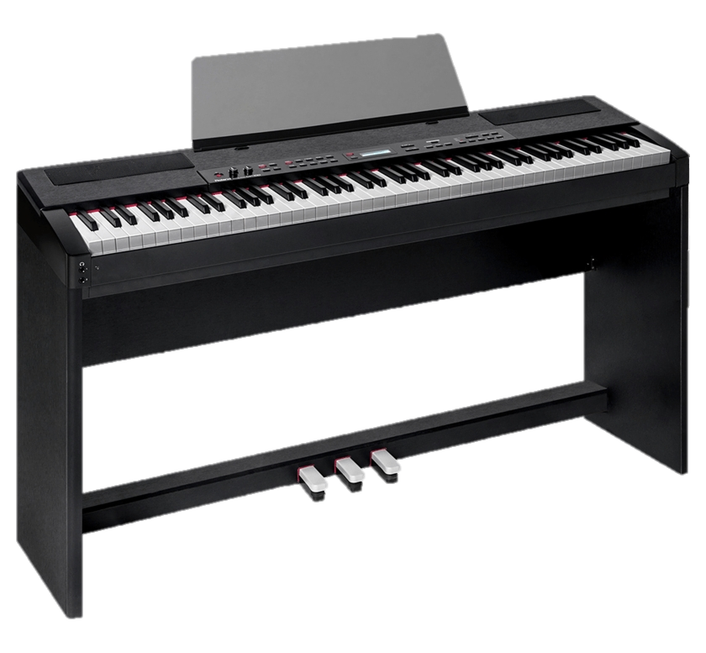
Our Music Learning Journey
Sixth Form
Solo & Ensemble Performance Recordings
One solo and one ensemble performance will be completed and recorded for coursework
Appraising Music
Throughout year 11 we continue with theory and set works ready for your exam at the end of the course
Composition Skills
Developing compositions skills through a study of Club Dance Music; Film Music; Theme and Variations;
11
Set Brief Composition
Using the briefs set by the exam-board to create composition 2
Free Brief Composition
Learning about and completing your first GCSE composition (composing to your own brief)
Appraising Music
Throughout year 10 we learn about the music theory and set works required for your appraising examination
Dance Music
Developing performance skills through a study of Dance Music from different times and places
10
Popular Music
Developing composition techniques, harmonisation, music technology in a Rap/Hip Hop genre
Popular Music
Developing performance skills through a study of famous Rap/Hip Hop/ Rn B songs
Performing Skills for GCSE Music
Introducing GCSE performance skills and starting two years of developing solo and ensemble pieces
Fusion
Developing composition skills through a study of musical fusion
Film Music
Developing performance skills through a study of famous film theme tunes
9
Film Music
Developing composition skills through Haunted House Composition
Structure
Theme and Variations composition using Alan Walker`s Faded melody as a theme
Structure
Developing understanding of musical structure within a performance of Fur Elise
Rock n Roll
Developing composition skills by composing a piece using the harmonic and melodic features of Rock n Roll genre
Repeating Patterns
Exploring repeating patterns with a keyboard performance of Stand By Me
Rock n Roll
Developing performance skills through a performance of Hound Dog
8
Video Game Music
Developing composition skills through Character Theme composition
Blues Music
Developing composition skills using the 12 bar blues
Repeating Patterns
Exploring repeating patterns through a composition based on Pachelbel`s Canon
Video Game Music
Developing an understanding of ‘Musical Themes’ in Video Game Music
7
Blues Music
12 Bar Blues performance and improvisation skills on the keyboard
Programme Music
Developing composition skills using the musical elements
Programme Music
Exploring the Elements and developing performance skills on the Keyboard.
Welcome to SNCHS Music Department!

