Slide 1
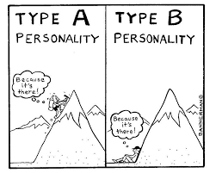
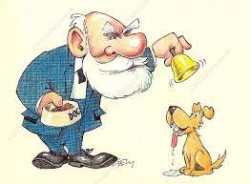
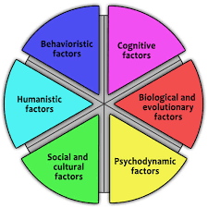
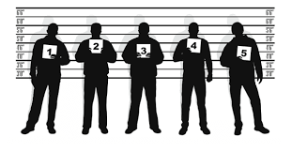
Identifying and understanding customer needs
Psychology A Level
Learning Journey
Paper 3
Issues and Debates
Revision
Freewill vs. Determinism
Reductionism vs. Holism
Cultural Bias
Prochaska
CBT
Aversion Therapy
Learning exp. of Gambling
Exams
Dates
Friday 17th May
Wednesday 22nd May
Monday 3rd June
Year 13
Pentecost Term
Learning exp. of Nicotine
Neurochemical exp. of Nicotine
Idiographic vs. Nomothetic
Nature
vs.
Nurture
Ethics & S.Sensitvity
Gender Bias
TPB
Covert Sensitisation
Cognitive exp. of Gambling
Describing Addiction
Risk Factors
Gender Differences
Paper 3
Addiction
Mock Exams
Paper 3
Stress
Social Support
Paper 3
Gender
Sex Role Stereotypes
Androgyny
Chromosomes & Hormones
SLT
Culture
Atypical Development
Immunosupression
Measuring Stress
Managing & Coping
Definitions of Abnormality
Year 13 Lent
Term
Hardiness
Biological Treatment of OCD
Sex & Gender
Atypical Chromosomes
GST
Media
Kohlberg
Psychodynamic
Physiology of Stress
Type A & B
Cardio- vascular
Sources of Stress
Type C Personality
Cognitive Treatment Of Depression
Behavioural Treatment of Phobias
Paper 2
Comparison of Approaches
Paper 2
Biopsychology
Behavioural Exp. Of Phobias
E.Pacemakers & E.Zeitgebers
Plasticity & Functional Recovery
Probability & Significance
The Sign Test
Levels of Measurement
Peer Review
Validity
Biological Exp. Of OCD
Year 13 Advent
Term
Features of Science
Cognitive Exp. Of Depression
Characteristics of phobias, depression & OCD
Biological Rhythms
Split Brain & Hemispheric Lateralisation
Synaptic Transmission
Recap of Yr 12
Type 1 & 2 Errors
Choosing a Test
Reliability
Implications for the Economy
Paper 1
Psychopathology
Paper 2
Biopsychology
Research Methods
Bandura
Cognitive Approach
Humanism
Neurons
The Endocrine System
Mock
Exams
Thematic &
Content Analysis
YEAR
Social Learning Theory
13
Year 12
Pentecost Term
Behaviourism
Design a Study
Skinner
Psychodynamic Approach
Biological Approach
Divisions of the Nervous System
Fight or
Flight
Localisation of Function
Ways of Studying the Brain
Research Methods
Meta-Analysis
Wundt & Emergence of Science
Pavlov
Bowlby’s Monotropic Theory
Learning theory of Attachment
Strange Situation Exam Style Qs
Multiple Attachments & Role of the Father
Reciprocity & Interactional Synchrony
Institutionalisation
Types of Attachment
Paper 2
Approaches
Paper 1
Attachment
Maternal Deprivation
The influence of early attachment on childhood and adult relationships
Cultural
Variations
Animal Studies
Schaffer’s Stages of Attachment
Observations & The S.Situation
Case Studies
Measures of Dispersion
Distributions
Paper 1
Social Influence
Explanations for Obedience:
Agentic State, L.Authority, Situational Variables
Correlations
Re-cap of Previous RM Topics
Qualitative & Quantitative Data
Variables affecting Conformity
Resistance to Social Influence
Social Change
Primary & SecondaryData
Year 12 Lent
Term
Ethics
Research Methods
Exam Technique (PPQs)
Self Report Methods
Types & Explanations of Conformity
Conformity to Social Roles
Dispositional Explanation for Obedience
Minority Influence
Mock
Exams
Pilot
Studies
Paper 1
Memory
Report Writing & Peer Review
Descriptive Stats & Graphs
Types of Experiment & Experimental Design
Induction & Introduction to Research Methods
Re-Cap of Induction Topics
Research Methods
Explanations for Forgetting
D.Characteristics & I.Effects
YEAR
12
Improving accuracy of EWT & C.Interview
Year 12 Advent
Term
Factors affecting accuracy of EWT
Types of LTM
The Working Memory Model
Multi-Store Model
Conducting Research,
Control & Standardisation
Variables
Population
&
Sampling
Aims
&
Hypotheses

