Slide 1
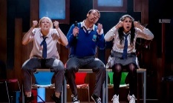
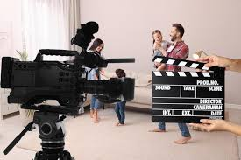
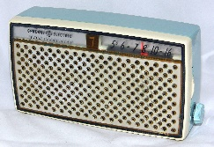
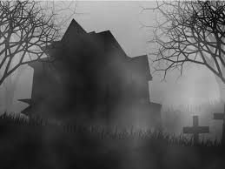
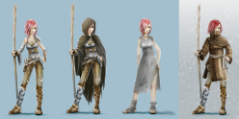
Drama Learning Journey
Question: Is it important to stay true to a playwright’s intention?
(Component 1) Understanding Drama - Study of set text Blood Brothers.
Characterisation
Vocal Skills
Physical Skills
(Comp 3)
Progression to next stage of learning:
A Level Drama & Theatre
BTEC Performing Arts
Performing Arts Colleges
Understanding
Drama
Playwright intentions, deconstructing text, Willy Russell, Social & Historical context/Billy Elliot
(Component 1)
Set & Staging
Costume
Lighting
Sound
(Component 1)
Question: How can you communicate effectively to an audience? (Component 3) study of plays for monologues and group work
Emotion memory
Given circumstances
Texts in
Practice
Proxemics
Direct Address
Narration,
Multi Role
(Component 2 – Devising)
Question: Whose style is it anyway?
(Component 2 & 3)
workshops on different practitioner’s
Styles such as
Brecht,
Artaud,
Boal,
Understanding
Drama
11
Devising
Drama
Style &
Genre
Students will
explore a range
of stimuli through
‘Intro to Devising’ workshops.
They can then use their knowledge of conventions, performance styles, genre & form to devise a piece of theatre. (Component 2)
Question: What type theatre is more powerful, naturalistic or non-naturalistic? Explore a range of performance styles and texts including:
Brecht, Stanislavski, Berkoff, Artaud, Verbatim, Frantic Assembly (Component 2 & 3)
Create: Write individual radio plays using new skills and techniques.
T3. We will explore some of Shakespeare’s history and look at the tragedy of Macbeth, deconstructing the text and writing about how we could stage the play in a modern context.
Text
Exploration
Evaluate: Peer-assess group work (own and others) using Yr8 criteria.
Technical Knowledge: Costume,
Props,
Staging,
10
Assessment:
Creating
Responding
Live Theatre
‘Macbeth’
Text exploration
Perform: Teacher, peer and self-assess performance skills using Yr9 criteria.
Assessment:
Performing
Responding
T3. Practically exploring a style of drama that many will already be aware of – Musical Theatre. Students will also explore technical design skills.
Perform: Teacher, peer and self-assess performance (physical or design) using Yr8 criteria.
Create: Devise – Using a selection of scripts to create a piece of TV acting in a Stanislavkian style.
Evaluate: Self and peer-assess group work (own and others) using Yr9 criteria.
Evaluate: Students comment on how drama is created and communication of meaning.
Perform: Teacher, peer and self-assess performances using Yr9 criteria.
T1. We will look at the work of a Theatre
Practitioner, and put into practice his methods in a TV drama scene.
Assessment:
Creating
Responding
TV Acting
Stanislavski
Assessment:
Creating
Performing
Teechers
9
Live
Theatre
T2.
Looking at some of the characters and scenes from the stage play Teechers, trying to create comedy using multi-role. Characterisation ‘from page to stage’.
Musical Theatre
Style
Characterisation
Choreography
T2. Exploring a new style of drama (purely audio) in our study of Radio Plays.
We will look at how we explore plot, character, setting, sounds, language & structure of a text.
Create: Groups make a performance montage from
practical work in lessons.
Experience
- seeing live
performance
Perform: Teacher, peer and self-assess performances using Yr8 criteria.
Assessment:
Performing
Creating
Soundscape
Assessment:
Responding
Performing
Radio
Plays
Narrative
Create: Write individual radio plays using new skills and techniques.
Physical
Theatre
Evaluate: Peer-assess group work (own and others) using Yr8 criteria.
Soundscape
Technical knowledge-
SFX
Create: Devise – Using a selection of techniques and conventions to create a piece of work about Darkwood Manor
T1. Looking at a different style of theatre, particularly Physical Theatre and the style of ‘Frantic Assembly’. Exploring how someone can turn a novel into a stage performance.
Vocal Skills – 5Ps
Multi-Role
T3. Looking at problem-solving, tension creation and building plus learning about what makes a good story through the medium of a local haunted house.
Narration
Perform: Peer and self-assess performances using Yr7 criteria.
Curious
Incident
of the Dog In
the Night-Time
Physical Theatre
/ Soundscape
Teacher in Role
Assessment:
Performing
Creating
Technical Knowledge –
Staging and Stage Positions
Darkwood
8
Manor
Assessment:
Responding
Performing
Technical knowledge - Lighting
Perform: Peer and self-assess performances using Yr7 criteria.
PERFORMANCE TECHNIQUES
Create: Devise - re-tell a well-known story, using new techniques, student-led.
Physical Skills
(Head, Shoulders, Knees and Toes)
Evaluate: Peer-assess group work (own and others) using Yr7 criteria.
T1. Looking at how to build our ability to tell stories through drama using new, learnt or improved drama conventions and techniques.
Vocal Skills – 5Ps
Evaluate: Peer-assess group work (own and others) using Yr7 criteria.
Assessment:
Creating
Responding
7
Story-Telling Skills
Bugsy Malone
T2. Looking at how to bring written characters to life (characterisation) in order to better perform from ‘the page to the stage’
Narration
Multi-Role
Freezeframe / Still Image
Mime
Cross-cutting
Writing in Role
Physical Theatre / Soundscape
Hotseating
Thought-Tracking

