Slide 1
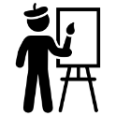
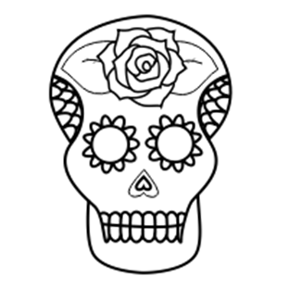
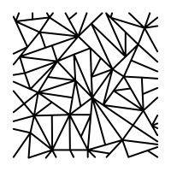
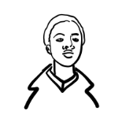
The Art Learning Journey
Produce a meaningful personal outcome (AO4)
Understand how to develop ideas using a range of medias and techniques. A01
Experiment with a range of materials, techniques and processes.
Produce a meaningful personal outcome (AO4
Develop ideas using artist knowledge and creative techniques.
Record observations from chosen assignment title/theme.
Review and refine ideas using a range of media
Externally Set Assignment
Develop Art vocabulary through careful written analysis.
Study a range of artists such as Abby Diamond and Sian Storey. Produce personal response and own written artist analysis.
Review and refine ideas using a range of media such as watercolour and acrylic paint.
Develop ideas using artist knowledge and explore a range of medias and techniques.(A01)
Study a chosen culture and plan a final design.
Produce a meaningful personal outcome linked to birds and one chosen culture. (AO4)
Explore Ian Murphy creative techniques and surfaces.
Understand how to capture your own creative photographs of architecture.
Ian Murphy
artist workshops
Year 111
Understand how to apply a range of media with skill
Architecture
Record detailed observational
drawings of architecture using pencil.
Record careful observational drawings inspired by birds (AO3)
Introduction to GCSE Art and the key assessment objectives
To know how to develop a personal and informed response.
Design personal slogan Art based on chosen issue.
Learn a
range of creative processes and techniques.
Working as an ‘Artivist’
Year 10
Birds
Understand the key style of the artist Roy Lichtenstein
Learn about the artist Jasper Johns
Produce a personal response in watercolour.
What is Pop Art?
How to create typography
How to use one and two point perspective
Research the artist Bob & Roberta Smith
Creating a mood board?
Understand how to produce a meaningful personal response
Text and image
Learn about street Art, & Protest Art and a range of world issues
To know how to creatively explore a range of mixed media.
Awareness of the principles of design.
Record through printmaking, drawing and watercolour painting.
Awareness of the principles of design.
Knowledge of the Art and Culture of the Mexican festival Dia de Muertos.
Year 9
To consolidate the use of the Art formal elements
Day of the Dead
Produce personal response inspired by contemporary artists.
Learn about the styles and periods of architecture
To develop knowledge of Architectural terms and the work of historic and contemporary Architects
To understand how the scheme links to potential careers in architecture.
To know how to use construction skills to design and create a card relief sculpture
Develop drawing skills focusing on the features of the face
.
To learn to record from observation
Year 8
Portraits
Architecture
Respond to the pattern work of Nikki Farquharson
To gain an understanding of the The Brothers Grim, and how the stories can inspire Art.
Be able to shade, layer and blend with coloured pencil crayon.
Medieval monster illustrations sheet
Create an imaginative design for a line drawing.
Learning about the style of Jon Burgerman.
Learn about still life and how to create your own still life set up.
Still life observational drawings and paintings.
Understanding of the Formal elements
Illustration project.
Still life project
Year 7
Presentation styles and working within a sketchbook
Create a final design inspired by a contemporary commercial artist.
Develop ability to successfully use an Art vocabulary
Contextual understanding of still life artists.
Understand the basics of drawing.
Understanding the value of Art.
What is Art? Art careers.

